Slide 1
Cross-Platform Mobile Application Development with Xamarin
Module 3, Lesson 1:
Mobile Development Survey
Notes:
Images and excerpts from Xamarin Mobile Application Development by Dan Hermes http://amzn.to/1rowG7K

Slide 2
Topics
Types of Mobile Application Development
Native
Cross-platform
Hybrid

Slide 3
Objectives
In this lesson you will learn about:
Native mobile app development
Cross-platform development
Pros/cons of native app development
Pros/cons of cross-platform development
Common approaches to cross-platform development

Slide 4
Native Mobile Development

Slide 5
Native Application Development
Uses platform-specific and proprietary tools
iPhone: Swift, Objective-C, and Xcode
Android: Java, Android Studio, and Eclipse
Windows Phone: C# and Visual Studio
Notes:
Notes:
The makers of each device develop tools and sometimes even their own languages to make the best applications possible.

Slide 6
Native iPhone Development
Xcode integrated development environment (IDE)
https://developer.apple.com/xcode/download/
iOS SDK uses the Objective-C/Swift programming languages
https://developer.apple.com/swift/asq
Notes:
Notes:
Other IDEs can be used, but they may not be able to build the code.
Rather than using an IDE, code can be written in a basic text editor.
Add in objective-C/Swift comparison
Why Xcdoe/obj-C/Swift

Slide 7
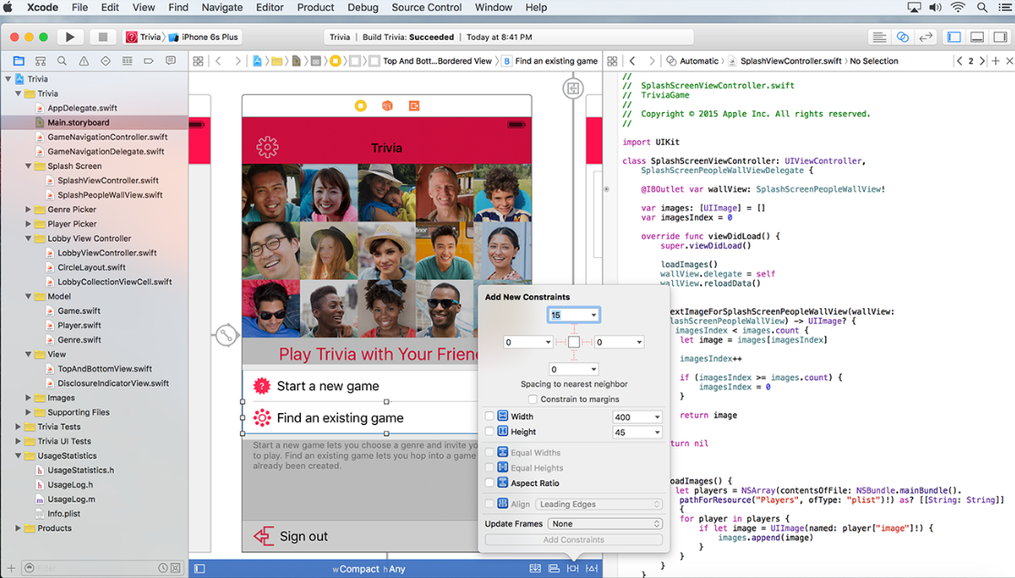
iPhone: Xcode
Notes:
Notes:
Xcode IDE
References:
Image courtesy of Apple

Slide 8
Native Android Development
Eclipse IDE
https://eclipse.org/downloads/
Android SDK uses the Java programming language
http://developer.android.com/index.html
Notes:
Notes:
Why Eclipse/Java
IDE choices

Slide 9
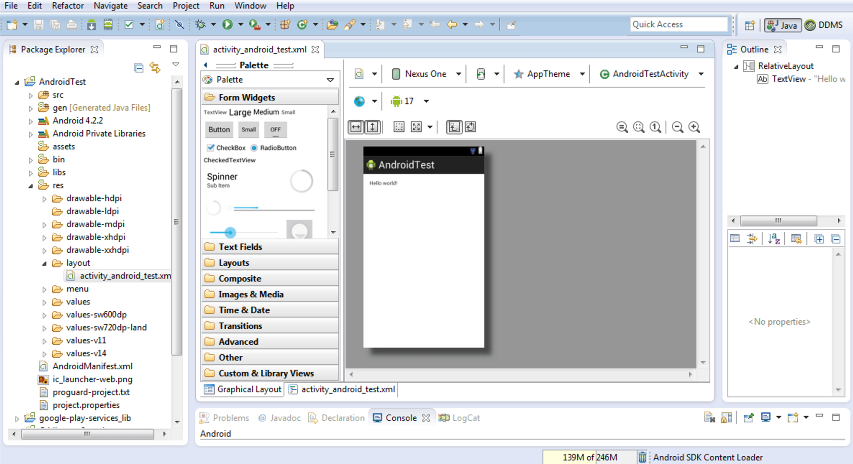
Android: Eclipse
Notes:
References:
Image from Android Studio 2 Development Essentials by Neil Smyth

Slide 10
Android: Android Studio
Android Studio
https://developer.android.com/studio/index.html
Uses Java programming language
Notes:
Notes:
Why Eclipse/Java
IDE choices

Slide 11
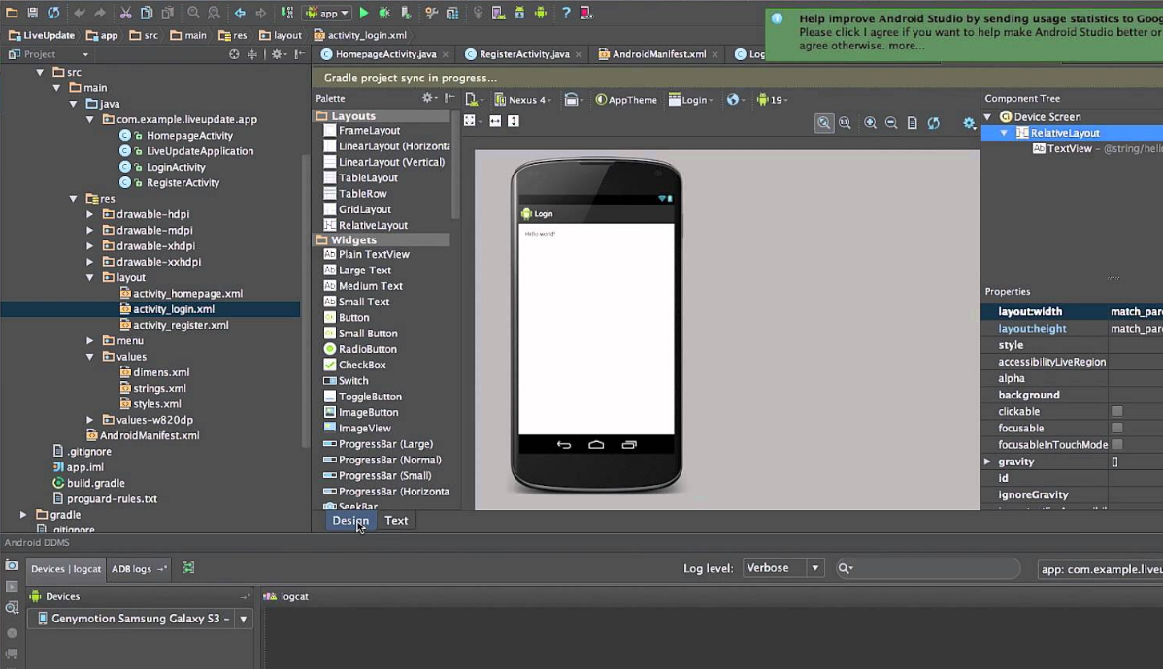
Android: Android Studio
Notes:
References:
Image from Android App Development with Android Studio IDE video with Ronny Kibet

Slide 12
Native Windows Phone Development
Visual Studio IDE
https://www.visualstudio.com/en-us/downloads/download-visual-studio-vs.aspx
Windows Phone API uses the C# programming language
https://msdn.microsoft.com/en-us/library/windows/apps/ff626516(v=vs.105).aspx

Slide 13
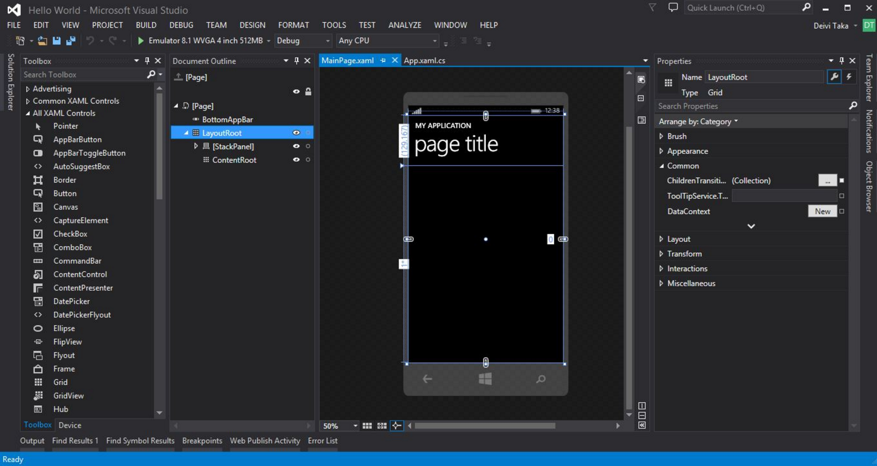
Windows Phone: Visual Studio
Notes:
References:
Image courtesy of Deivi Taka at SitePoint

Slide 14
Benefits of Native Development
Supported by Makers of Device
Highest Quality Applications Possible
They want you to make great apps for their device
Provide support to developer communities
All device features accessible
Optimized for a single platform
All graphics and interactivity features available

Slide 15
Drawbacks of Native Development
Separate Teams
Hard to Reuse Code
Teams have different skills
Use different programming languages
Use different tools
Rewrite all code again for each platform
Code bug fixes and added features separately on all platforms
Notes:
Notes:
Apps developed for particular devices work only on those devices.
Multiple development teams must exist to build the same app for different devices.
Each team is required to use different tools and languages.
Application code cannot be shared due to device differences.
Choosing this approach favors quality over cost and time to market.
Cross-platform core C++ app code is possible, but expensive (AllJoyn).

Slide 16
Native Development Pro/Con Summary
Pros
Cons
High Quality
Performant (Fast)
High-end Graphics and Interactivity
Time-consuming
Costly
Notes:
Notes:

Slide 17
Cross-Platform Mobile Development

Slide 18
Benefits of Cross-Platform Development
Combine code and development teams
Shared codebase
Same programming skillset
Notes:
Notes
Can save time by reusing code
Can save money

Slide 19
Cross-Platform Mobile Development
One code base works on multiple platforms
Uses more broadly-used technologies.
HTML, JavaScript
Platform-independent IDEs
{ }
{ }
{ }
iOS
Android
Windows
Shared Code Base
Notes:
Notes:
Many cross-platform mobile frameworks exist, although some don’t support all phones (like Windows Phone).
One code base working on multiple platforms allows some code reuse
Code reuse depends on the framework.
Frequently, web technologies like JavaScript, XML/HTML and CSS are used and don’t necessarily demand use of a particular IDE
IDEs are GUIs that pull together various tools like compilers and designers to enable development of an application.

Slide 20
Drawbacks of Cross-Platform Development
Device Support Varies
End-product Quality Varies
Certain OSes or devices may be supported better than others
Not all device features are supported
Performance can suffer
Performance can vary across platforms
Look and feel may differ from store-downloaded apps
Notes:
Notes:
Cross-platform mobile frameworks do not necessarily support all phones.
Obscure device features often not supported.
Some frameworks are very close to native in their performance, while others are not.

Slide 21
Cross-Platform Solutions
Each framework has its own benefits and drawbacks
Cross-Platform Development Framework | Defining Characteristics
Xamarin | Code in C# then compile to respective native platforms
Titanium, NativeScript & React Native | Native shell around a JavaScript core app
Cordova | Device-resident web app that can be wrapped in a native shell
Notes:
Notes:
Xamarin is the only major framework that compiles to respective native binaries for a 100% native application.
Appcelerator’s Titanium, Telerik’s NativeScript and Facebook’s React Native have 100% native UIs but offshore their logic to the native JavaScript engine.
References:
https://www.xamarin.com/
http://www.appcelerator.com/
https://facebook.github.io/react-native/
https://www.nativescript.org/
https://cordova.apache.org

Slide 22
Xamarin
Code in C#
Compile to a native executable
Create a native app for each platform
{ }
{ }
{ }
iOS
C# UI
Android
C# UI
Windows
C# UI
Xamarin Approach
Native with Code Sharing
Shared C# Code
Notes:
Notes:
Xamarin backend is mostly shared code, though some platform-specific code may be necessary.
UI code can be shared with Xamarin.Forms (explained in a later lesson); otherwise, UI code is platform-specific.
Code reuse among the UIs is achievable (also explained later).
Make stacked diagram for each approach.

Slide 23
Titanium, NativeScript, React Native
Two sides of development:
Native app shell
XML (or similar) translated to native UIs
Core logic and UI handled by native JavaScript engine
JavaScript used as-is or compiled to native language
Controls platform-specific UI using proprietary OS API binding
JavaScriptCore (iOS), V8 (Android), Chakra (Windows)
Notes:
Notes:
These front-end shells represent essentially two apps: the native app and JavaScript app.
Native app is just a UI.
JavaScript app handles all the logic, web requests, data handling, etc.
Functions are extremely similar for all three frameworks.
References:
http://developer.telerik.com/featured/nativescript-works/

Slide 24
Cordova Hybrid Framework
Web app installed on device
HTML and JavaScript UI
Native shell allows app store distribution
JavaScript API communicates with device using OS API
Cordova is the most commonly used hybrid framework
Notes:
Notes:
JavaScript API:
Basic support for device features
Native plugins can be built to add support for other features
PhoneGap was the old name for Cordova. Apache acquired and then renamed it.
PhoneGap is currently a distribution of Cordova.
PhoneGap is Cordova with Apache tools on top of it (like PhoneGap Build) .
Cordova is essentially the only hybrid framework.
Almost all other hybrid frameworks are built on top of it to reduce the pains of hybrid development
UI frameworks are built on top of Cordova to make them look and feel like a real, native app instead of a website.
Frameworks built on top of Cordova:
PhoneGap
Ionic
Onsen
Many others
References:
https://cordova.apache.org/
http://ionicframework.com/
https://onsen.io/

Slide 25
How Hybrid Frameworks Work
Web app is hosted in a native WebView
WebView is hosted in a native app shell (ex. Java on Android)
Native shell listens for calls from the hybrid JavaScript API
Native App Shell
Native WebView
Web App
Notes:
Notes:
Hybrid frameworks have a small JavaScript API that the app developer uses to communicate with the device.
References:
WebViews: http://developer.telerik.com/featured/what-is-a-webview/
Cordova’s API: https://cordova.apache.org/docs/en/2.4.0/

Slide 26
Quiz
What is the biggest advantage of writing separate mobile applications in their native languages?
a. It’s the cheapest option
b. It’s the least time-consuming option
c. Provides the highest quality experience possible
Notes:
Answer: c

Slide 27
Quiz
What is true of hybrid mobile applications?
a. Host locally-installed web apps
b. Compiles to native binaries
c. Provides native user interfaces
Notes:
Answer: a

Slide 28
Quiz
Which is true of technologies like Appcelerator’s Titanium, Telerik’s NativeScript, and Facebook’s React Native?
a. C# is the main language used
b. Primarily uses WebViews to host UI
c. Provides native user interfaces
Notes:
Answer: c

Slide 29
Quiz
Which is true of Xamarin?
a. C# is the main language used
b. Compiles to native executables
c. Primarily uses WebViews to host UI
d. Only a and b.
Notes:
Answer: d

Slide 30
Summary
In this lesson you have learned about:
Native mobile app development
Cross-platform development
Pros/cons of native app development
Pros/cons of cross-platform development
Common approaches to cross-platform development

